Slide 1
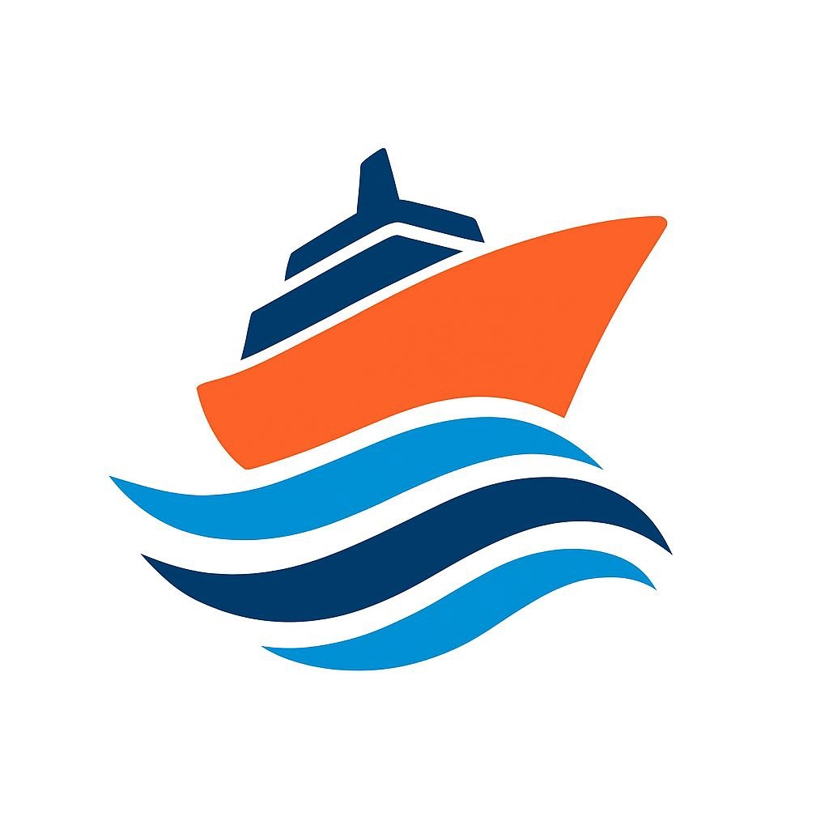
Supply Chain Data Analysis
Focus: Analyzing supply chain data to extract insights and provide recommendations
November 20, 2025

Slide 2
Prepared by:
Islam Nabih Yusuf
Bassent Magdy Youness Said Ahmed
Nancy Magdy Youness Said Ahmed

Slide 3
The Idea
Our project aims to analyze the full Supply Chain cycle to identify key performance trends across suppliers, products, and manufacturing.
The goal is to understand:
Which suppliers deliver the highest value
Which products generate the most profit
Where delays, high costs, or defects occur
How transportation and lead time affect quality and performance
This analysis supports better decision-making in sourcing, production, and logistics.

Slide 4
Goals
- Analyze supplier performance in terms of quantity supplied, revenue contribution, shipping cost, and profitability.
- Study product movement, lead times, demand patterns, and shipping behavior.
- Evaluate manufacturing performance through production volume, defect rates, quality impact factors, and transportation influence.
- Identify bottlenecks and improvement opportunities across the supply chain.
- Provide actionable insights that enhance efficiency, reduce delays, and improve product quality.

Slide 5
What We Focused On
We focused on analyzing the core Supply Chain KPIs including:
- Supplier performance (quantity, revenue, profit, shipping cost)
- Product performance (lead time, cost, demand, shipping time)
- Manufacturing metrics (defect rate, production volume, routes, quality vs cost)
- Transportation impact on quality and delivery
- Relationship between Lead Time & Defects
The main focus was identifying patterns that affect cost, quality, and efficiency.

Slide 6

Data Overview
- The dataset covers three main processes: Suppliers, Products, and Manufacturing.
- Data includes quantities, revenue, shipping cost, locations, defect rates, and timelines.
- No cleaning was required; all data was ready for analysis.
- We developed DAX measures to calculate KPIs such as revenue, profit, defect ratio, lead time, shipping time, and delay rate.

Slide 7
Key Insights Summary
- Supplier 1 has the highest performance in revenue, profit, and delivered quantity.
- Skincare products are the top-selling and highest-profit category but also have the highest defect rate.
- Cosmetics have the lowest cost and lowest defect rate, making them the most stable category.
- Lead Time increases defect rates; longer production or delivery cycles = higher defects.
- Transportation mode affects quality: Road shows higher issues compared to Rail & Sea.
- Route A has the highest production/shipment volume.
- The most requested quantity comes from Skincare, matching the highest demand trend.

Slide 8

Final Project

Slide 9
Recommendations
- Improve quality control for Skincare, especially during production & transportation.
- Increase sourcing volume from Supplier 1 due to strong performance.
- Shift more shipments to Rail/Sea to reduce cost & defects.
- Optimize Lead Time by reducing bottlenecks in manufacturing steps.
- Expand production of Cosmetics because they show the best stability and lowest defects.
- Review Route A capacity since it handles the highest volume.

Slide 10
Fixes We Made
- Created DAX measures for all KPIs (revenue, profit, lead time, defect ratio, shipping time, delay rate).
- Adjusted and validated relationships between suppliers, products, and manufacturing tables.
- Added calculated fields where needed to support analysis.
- Fixed visual-level filters to ensure each chart reflects the correct segment.
- Standardized logic for KPIs to match the updated questions.

Slide 11
Participation
- We collaborated together on the Overview analysis and dashboard structure.
- Islam handled the Supplier analysis.
- Bassent handled the Products analysis.
- Nancy handled the Manufacturing analysis.
- All team members contributed to the storytelling, insights, recommendations, and presentation design.

Slide 12
Conclusion
The analysis shows major variations in supplier performance, product delivery efficiency, and manufacturing quality.
By improving sourcing, optimizing shipping routes, and strengthening quality control, the company can reduce cost, decrease delays, and enhance overall supply chain performance.

Slide 13
Q&A / Thank You
-Thank you for your attention!
-We welcome your questions.

